Slide 1




Noisy Simulation Optimisation with Stocahstic Annealing
Alvaro Cabrejas Egea
Supervisors: Juergen Branke, Robin C. Ball

Slide 2
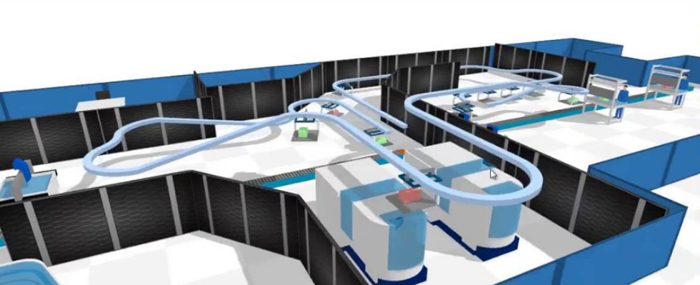
Simulation: A new paradigm
Recent advances in computing power redefined our relation with simulations
We can deal with massive parametric spaces
Applications in EVERYTHING: manufacturing, economics, epidemiology, social science…
First used to analyse
Optimise it!
Notes:
Advances in computing power in the last couple decades have changed our relation w/ simulation.
-Search+Simulate large search spaces
-Countless applications
-Analyse complex systems
-Optimise them

Slide 3
Optimisation Via Simulation of a Stochastic Process
Definition: Optimisation where the evaluation of a solution has to be obtained by running a simulation
Can be represented as: min f(x), x ϵ Θ
Assigns a performance measure to each parametric point x
f(x) represents the expected value of a random variable E[X(x,ω)]
X(x,ω) is the sample performance measure
x is the input variable (parameter)
ω is a sample path (simulation run)
Problems: Uncertainty due to noise or simulation constraints
Notes:
OvS is optimisation where the evaluation of a solution has to be obtained by running a simulation.

Slide 4
Optimisation Under Noise
Real world is inconvenient
Noise in measurements
Uncertainty in data Stochastic Simulations
High Variability
Consequence: Not always clear what is best, very difficult to compare any two solutions
Need of tools that can deal with noisy processes
Notes:
Being able to optimise under noise is the most interesting here.
Inconveniences of the real world make Stochastic Simulations good representations.
Difficult to know which solution is worse.
Need of tools that can deal with these problems.

Slide 5

Stochastic Annealing: What it is
Notes:
The name and inspiration come from annealing in metallurgy, a technique involving heating and controlled cooling of a material to increase the size of its crystals and reduce their defects. Both are attributes of the material that depend on its thermodynamic free energy.

Slide 6
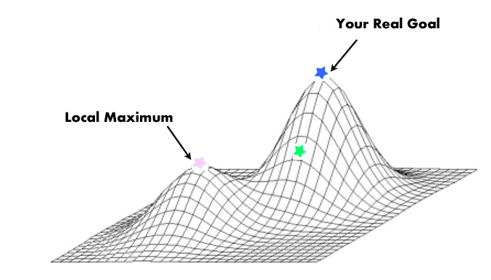
Stochastic Annealing: What it is
Greedy algorithms can be stuck in local minima/maxima
Many algorithms depend heavily on initial conditions
Approximate optimum
Good on large search space
Good for discrete space
Compromise power/speed
Samples correlated (MCMC)

Slide 7

Stochastic Annealing: How it looks

Slide 8
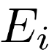
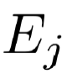
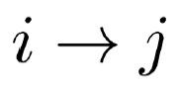
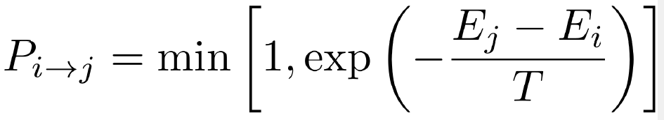
Stochastic Annealing: How it works
Kirkpatrick (1983) (adapting Metropolis-Hastings):
Initial i with energy (quality)
Randomly choose neighbour j with
Accept change with probability
Gradually decrease T according to schedule

Slide 9
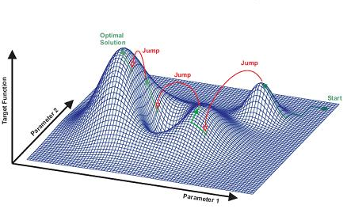
Experimental Terminology
Scenario
Replication
Run / Repetition
Current Solution
Best Solution

Slide 10
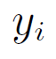
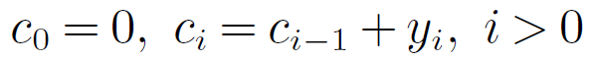
Optimal Stochastic Annealing
New algorithm meant for noisy performance measurements
Use of sequential sampling to achieve confident estimation
Codify sample in cumulative variables
Three way decision: Accept / Resample / Reject
Obedience to detailed balance is demanded from the system
Notes:
This is its first comparison against similar competitor algorithms.
Operates under the assumption that the noise is Gaussian of known standard deviation.

Slide 11
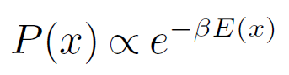
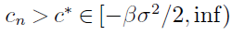
Quick Statistical Mechanics
A system is in equilibrium if the probability of it being in state x, P(x) follows the Boltzmann-Gibbs distribution
A sufficient condition for equilibrium is fulfilling detailed balance
This leads to an optimal acceptance probability
Rejection happens when
Highest acceptance chance at each step, guaranteed to converge to minimum if the annealing is slow enough
Notes:
Tuned for c*=0 is what we call OSA

Slide 12
Witness Horizon
Developed by Lanner Ltd. for Witness Horizon
Used via commercial software
Parameters
Parametric Space
Maximum Number of Scenarios
Annealing Schedule
Option for automatic Annealing Schedule
Notes:
It was discovered during simulation that uses:
Common Random Numbers
Custom Stepping Strategies
WE DON’T HAVE THE ACTIAL ALGORITHM: BLACK BOX

Slide 13
Schedule and Experimental Settings
Max Scenarios = 3.000
Potential Solutions = 3.600.000
Initial T = 20
150 Temperature drops
Geometric annealing, α=0.95

Slide 14
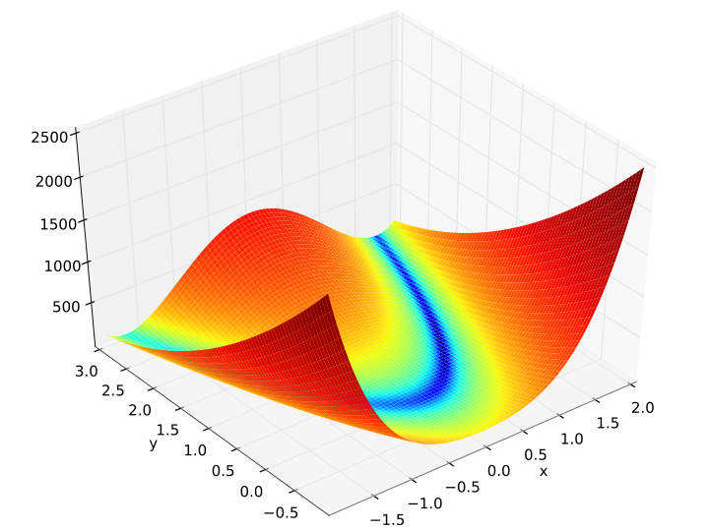
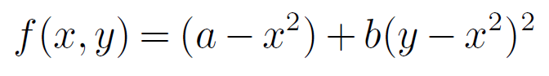
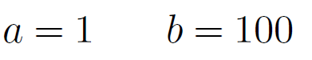
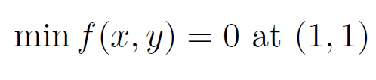
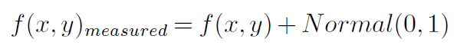
Test Problem - Rosenbrock Function

Slide 15
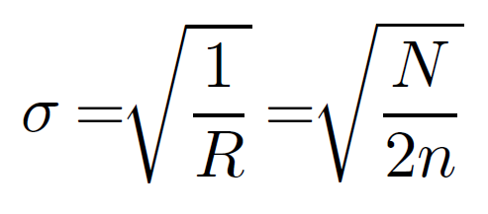
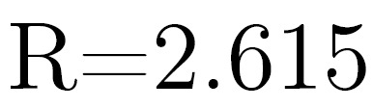
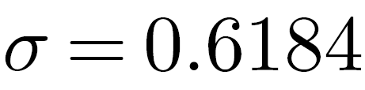
Prior Necessary Data
Adaptations needed to reduce the computational effort and make comparison fair
Same number of samples vs. same number of scenarios
Sample Mean’s Standard Deviation Scaling:
Notes:
Witness is prepared for running heavy simulations, so many replications in a quick fashion do not work well.
We could chose using same number of samples or same number of scenarios.
Same number of samples=OK
Scenarios no -> Adapt the noise, which will be reduced based on the ratio of the samples taken by OSA and WH.
2000 repetitions for R

Slide 16
Experimental Results
Notes:
Witness is prepared for running heavy simulations, so many replications in a quick fashion do not work well.
We could chose using same number of samples or same number of scenarios.
Same number of samples=OK
Scenarios no -> Adapt the noise, which will be reduced based on the ratio of the samples taken by OSA and WH.

Slide 17
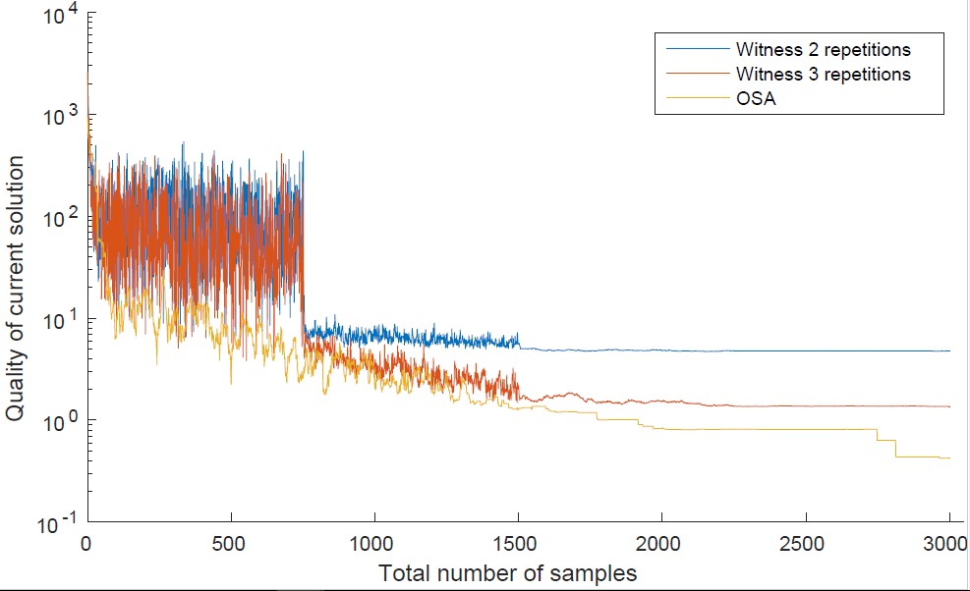
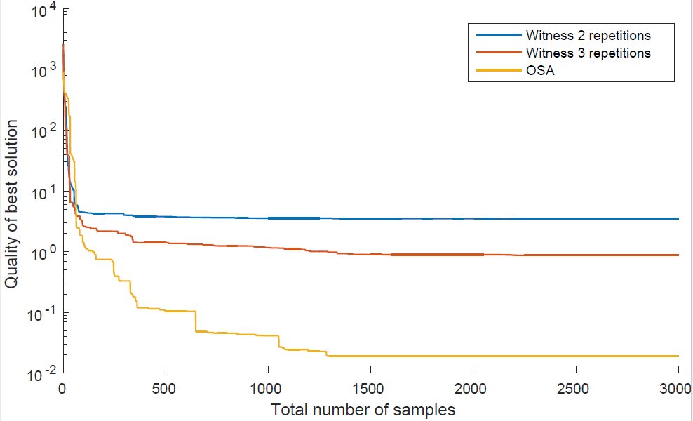
Experiment: Replication Scaling
Notes:
Average 20
Approximately same number of samples R=2.615

Slide 18
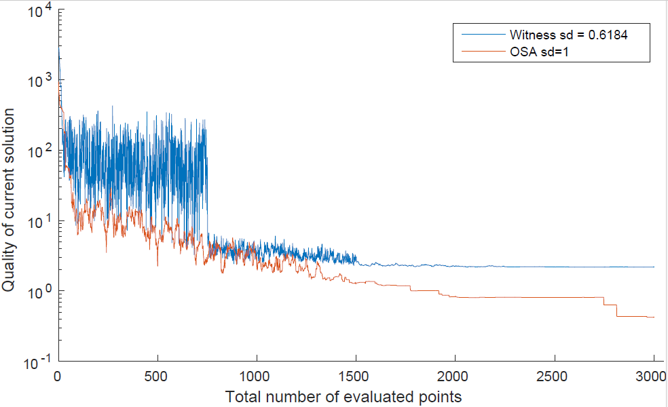
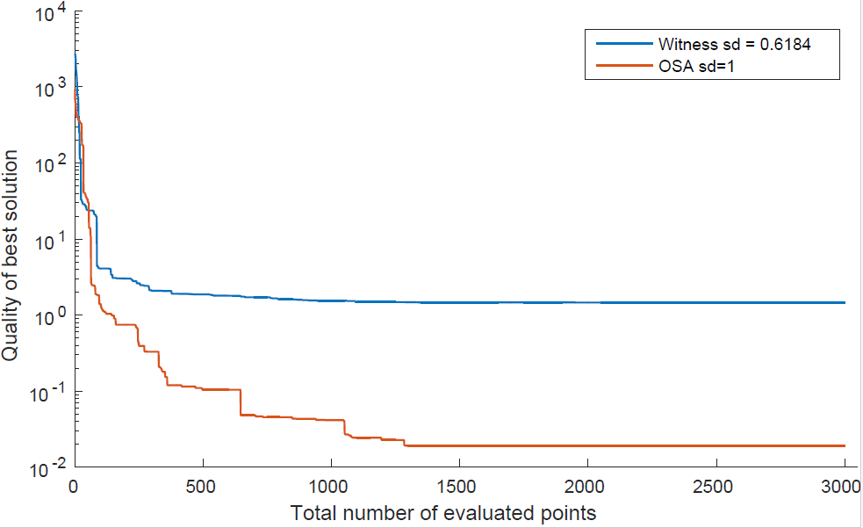
Experiment: Standard Deviation Scaling
Notes:
Average 20
Same number of scenarios. Method validated.

Slide 19
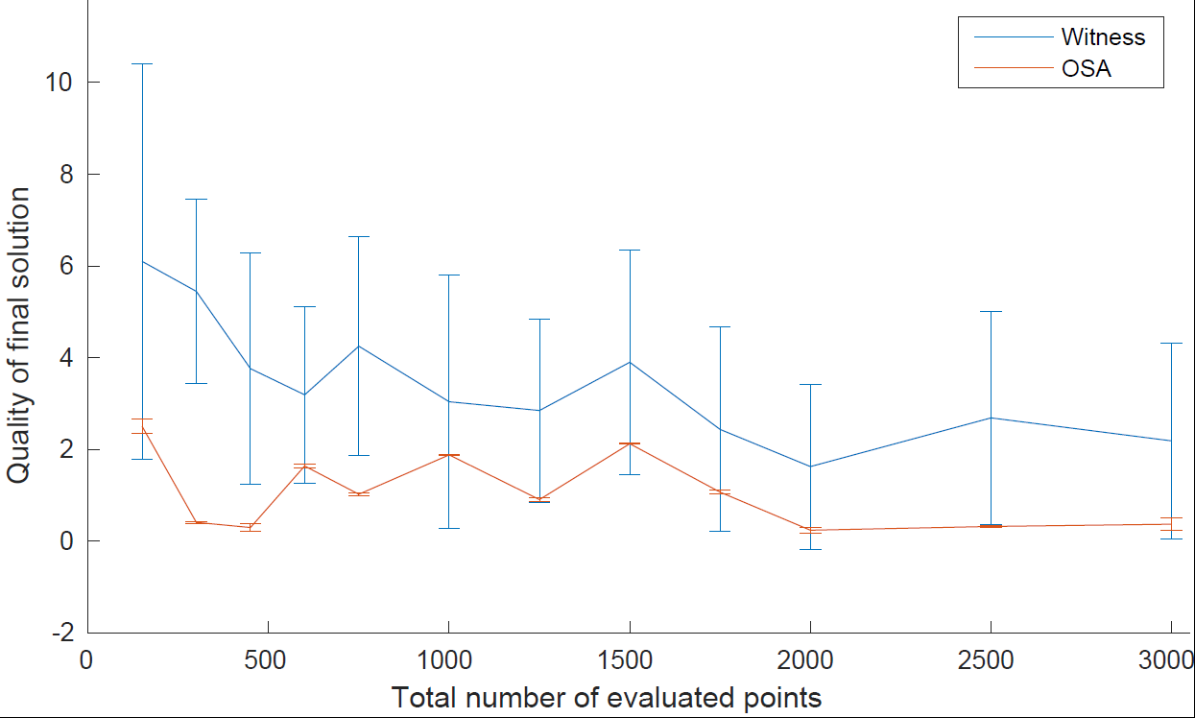
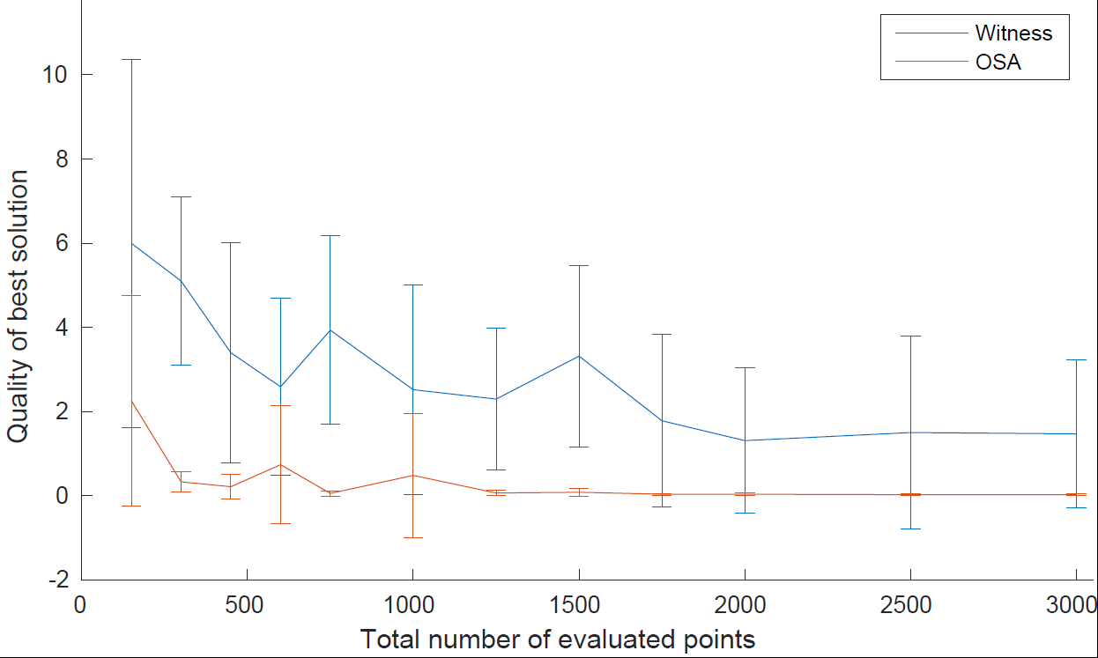
Experiment: Convergence
Notes:
Average over 10

Slide 20
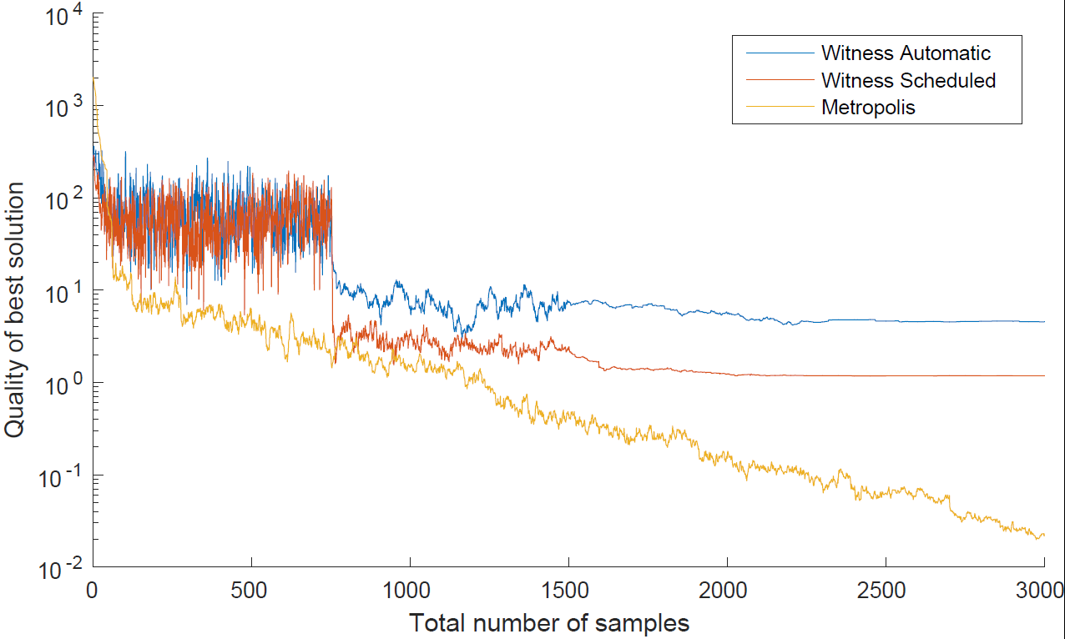
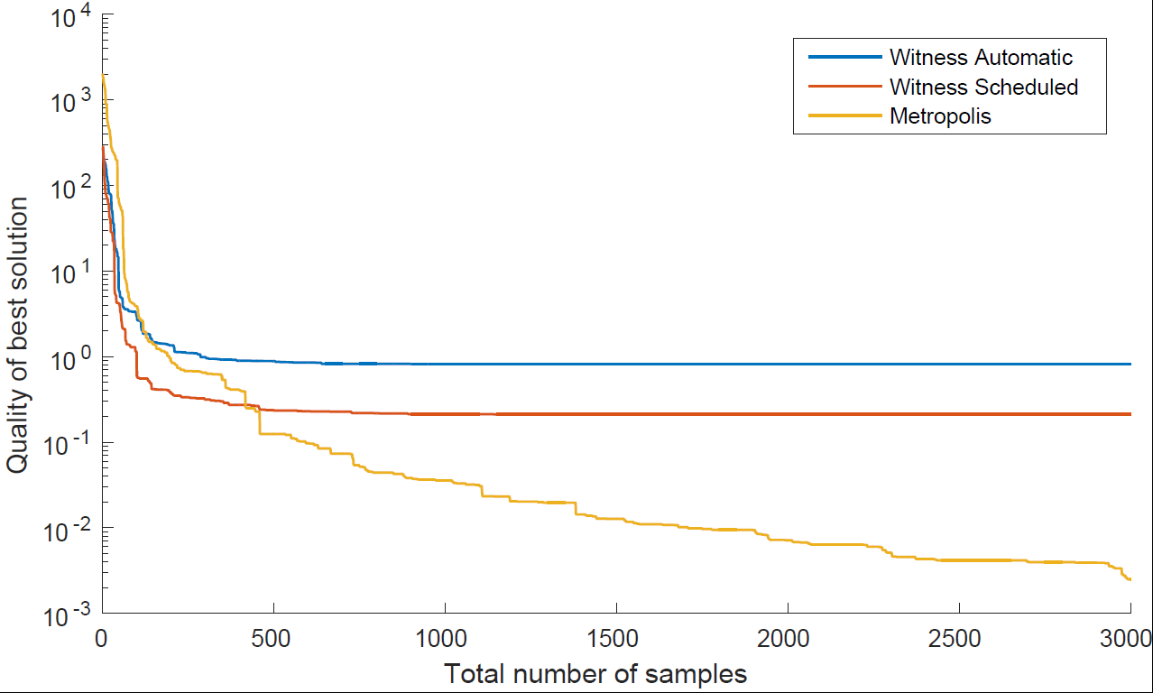
Experiment: Solution Generation Strategies
Notes:
Average 20
Since the we do not have the code of the algorithm, it was assumed than the acceptance probabilities would be close to those used in Metropolis, making them close enough to see the effect of the new solution generation.
Implementing it and comparing both, we can see that Metropolis descends constantly.
WH 3 phases, exploration, local exploration and fine tuning.

Slide 21
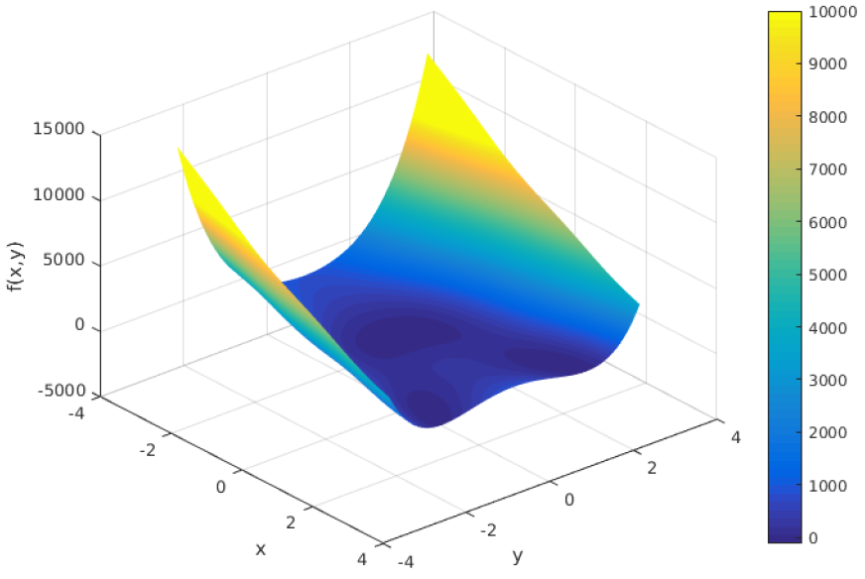
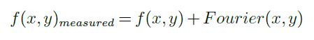
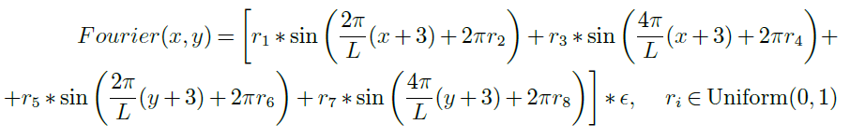
Noise: Random Fourier Series
Notes:
As said before: WH = Common Random Numbers.
Stream generated and used the entire run, which means that fitness landscape is offset and optimisation deterministic.
Prevent it, use a Random fourier series that implies different noise disturbance at each point.
Noise parameter epsilon.
Rest uniform.

Slide 22
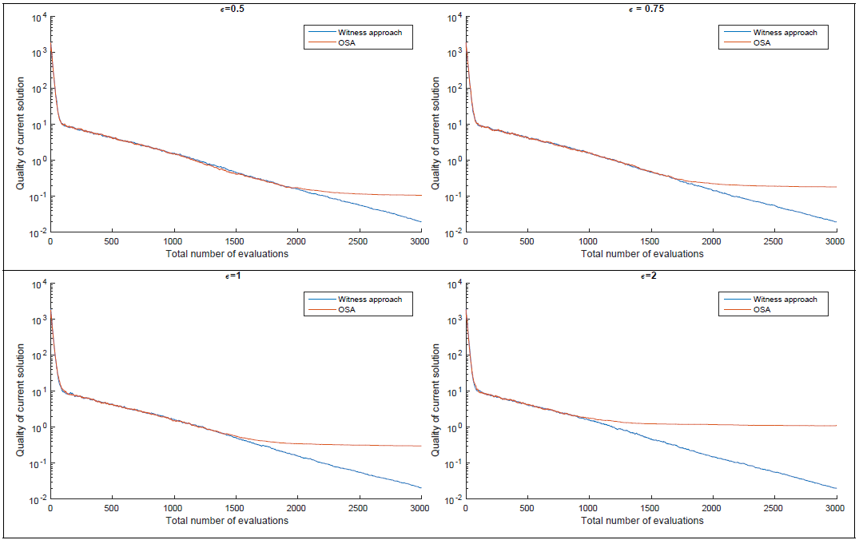
Experiment: Common Random Numbers
Notes:
Common Random Numbers implemented in Python with classic acceptance.
Both lines coupled, until temperature is low and noise to signal ratio is high.
Then OSA resamples, evaluating less points and having a lower probability of finding the true min.
The fact that the decoupling happens earlier in the run as the noise increases is consistent with this theory.

Slide 23
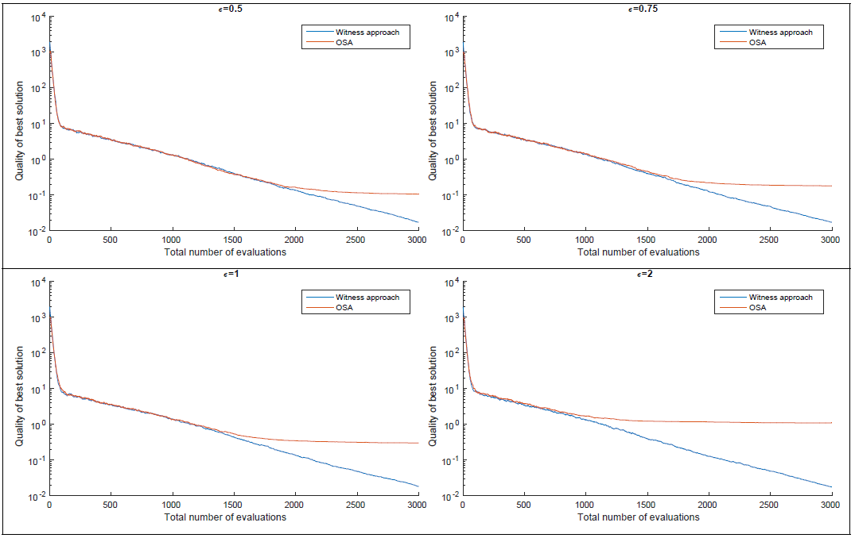
Experiment: Common Random Numbers
Notes:
Same behaviour.

Slide 24
Results Summary
Standard Deviation Scaling methods proven valid
OSA shows better and faster convergence than WH
OSA performs better for all run lengths
Solution proposal strategy in WH does not seem to play on its favour. Lack of data for stronger statement
Common Random Numbers has negative effect in the Rosenbrock problem
OSA’s resampling approach discourages fix sample size
Notes:
For reducing noise in the test, not inherent to system in real life.
Yes
Idem
3 behaviors don’t seem to add benefit
It has a positive one in Fourier, but the implementation is probably missing details about WH which were not obvious. No way to test.
Because OSA is by definition variable sample size. These adaptations play directly against it.

Slide 25
Further Work
Lesson Learnt: Do not experiment on commercial software
Complete algorithm / Pseudo-code should be obtained from Lanner Ltd. and implemented externally.
Comparison for acceptance probabilities generation under same energy/temperature ratios.
Extend OSA to work with non-Gaussian noise
Extend OSA to estimate the noise as it runs

Slide 26
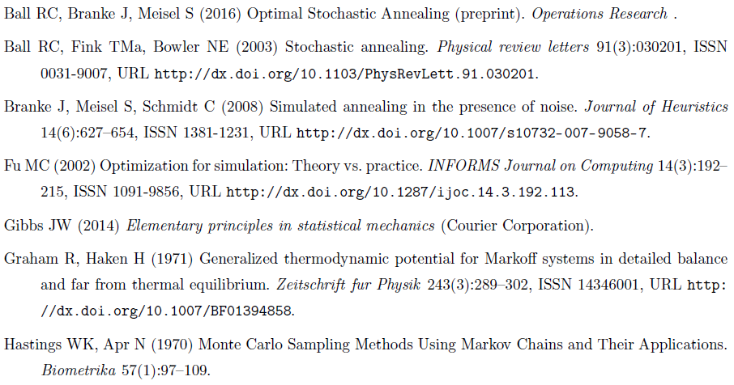
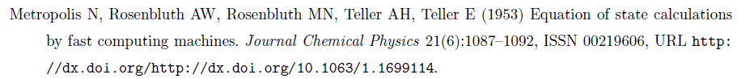
Related Literature

Slide 27
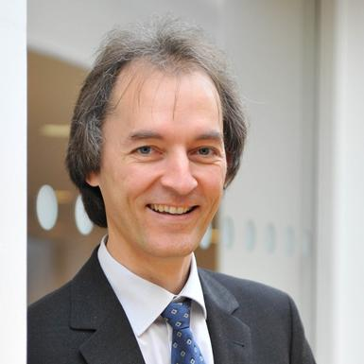

Acknowledgements

Slide 28

Thank you!
Any questions?

